Slide 1
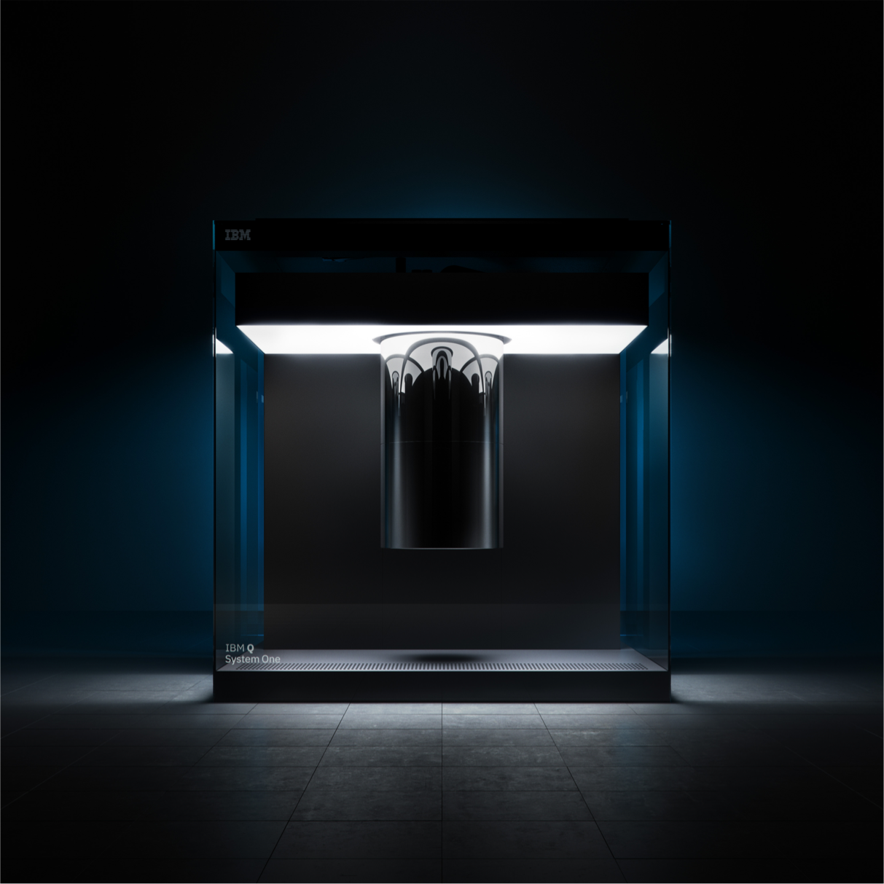
Introduction to Quantum Computing
James Wootton
IBM Research– Zurich
@decodoku

Slide 2
Quantum is not magic
flickr.com/brickset

Slide 3
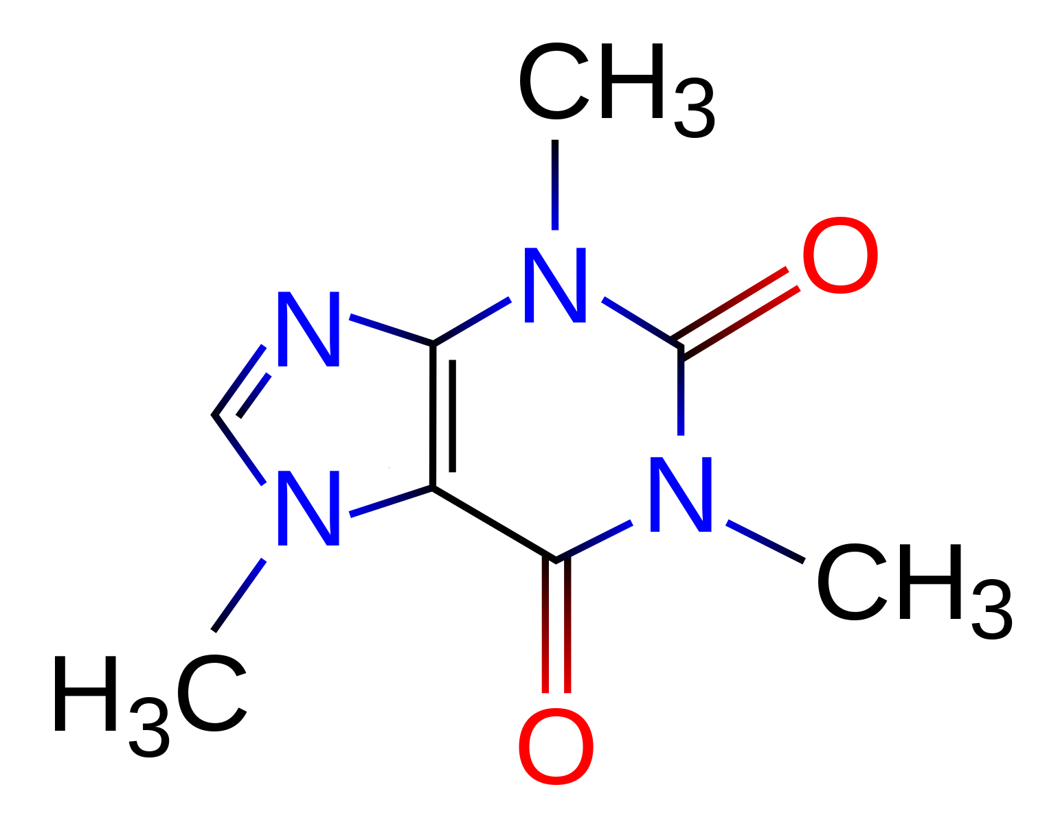
Some problems are just too hard for current computers

Slide 4
Qubits harness the power of quantum for computation

Slide 5

Quantum computing will be revolutionary in every field

Slide 6
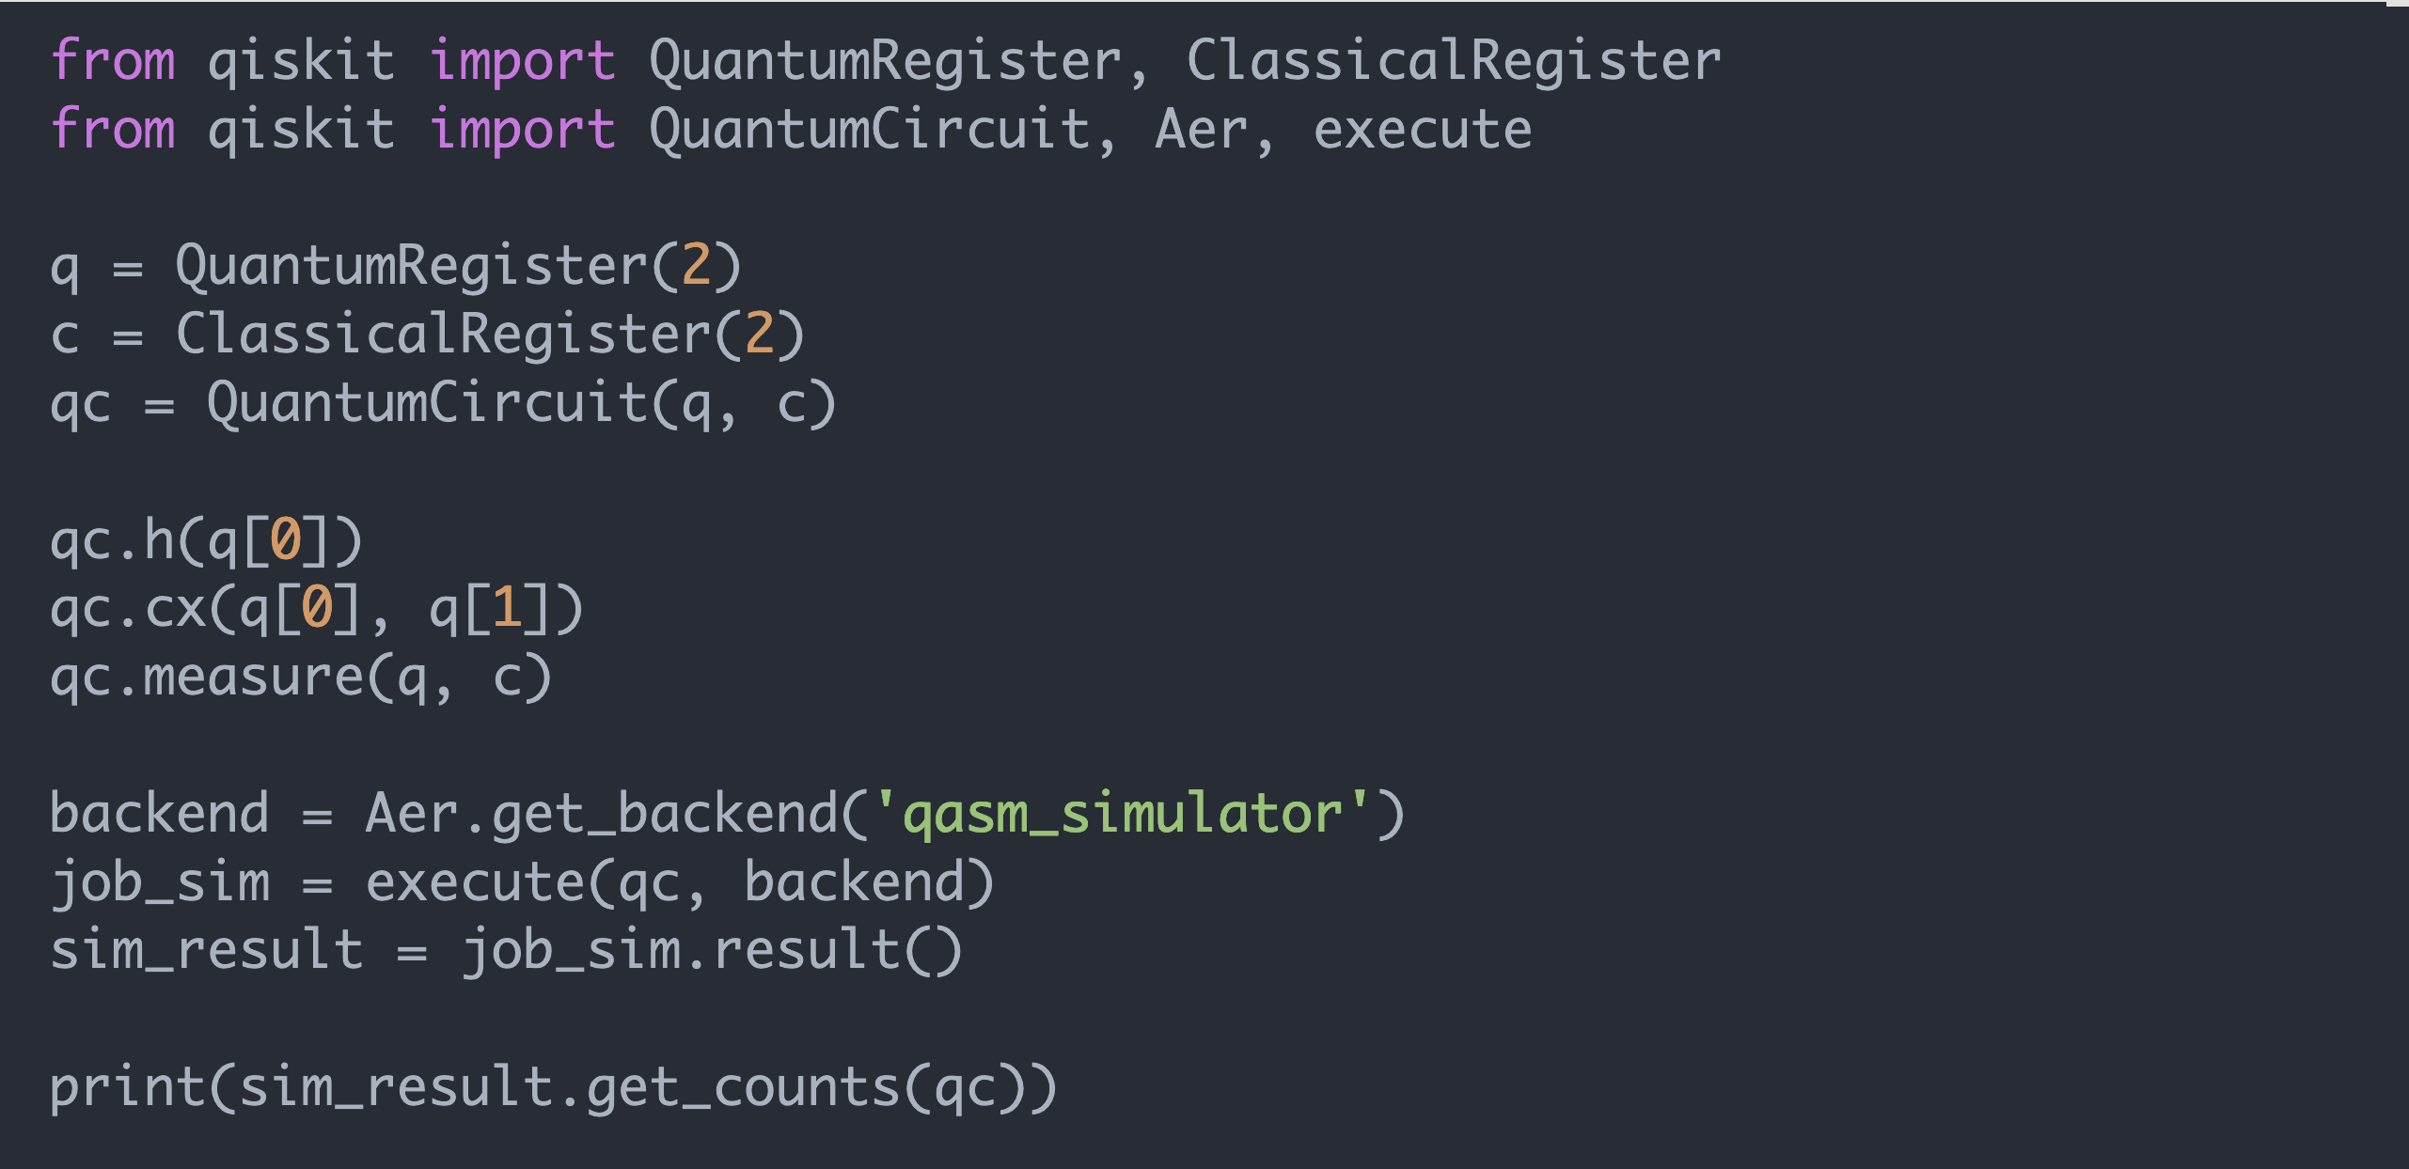
Programmer-friendly methods of creating quantum programs

Slide 7
1935
1964
1970
1981
Discovery of topological quantum order
The EPR Paradox
Bell’s Inequality
Birth of quantum information theory
First conference on physics of computation co-hosted by MIT and IBM
1982
1984
Experimentally factoring 15 (IBM)
Quantum cryptography (IBM)
1997
1996
1995
1994
1993
2001
Topological codes
DiVincenzo Criteria for building a quantum computer (IBM)
Quantum error correction
Shor’s Factoring Algorithm
Quantum teleportation (IBM)
Quantum computation is a work in progress
2004
Circuit QED is demonstrated
2007
2012
2015
2016
The transmon superconducting qubit
Coherence time improvement (IBM)
Demonstrate simple error correction code (IBM)
IBM makes quantum computing available on IBM Cloud

Slide 8
Plan for your future use cases
ibmqawards.com/quantum-game

Slide 9
A platform for science
ibmqawards.com/ibm-q-best-paper-award

Slide 10
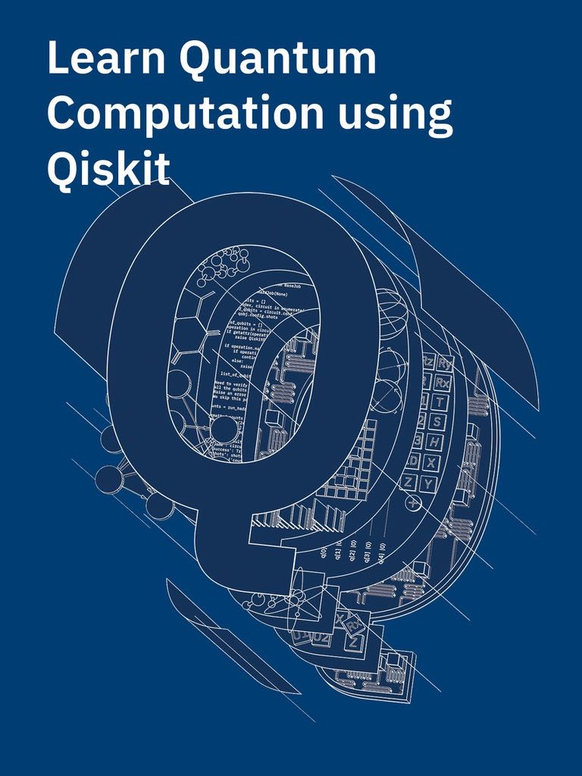
A platform for education
ibmqawards.com/teach-me-qiskit-video-award
ibmqawards.com/teach-me-quantum-award
ibmqawards.com/teach-me-qiskit-award

Slide 11
Contribute to an open source project
ibmqawards.com/developer-challenge-circuit-optimization

Slide 12
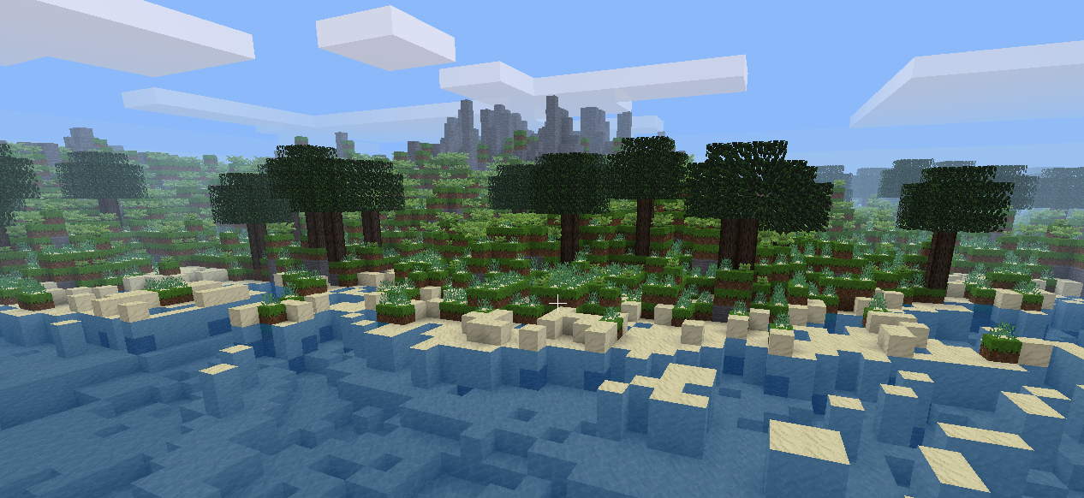
Just have some fun!
ibmqawards.com/quantum-game

